Slide 1
ML4MI Bootcamp: Network training strategies
Updated:
July 24, 2018
Contributors:
Alan McMillan( abmcmillan@wisc.edu )
Jacob Johnson (jmjohnson33@wisc.edu )

Slide 2
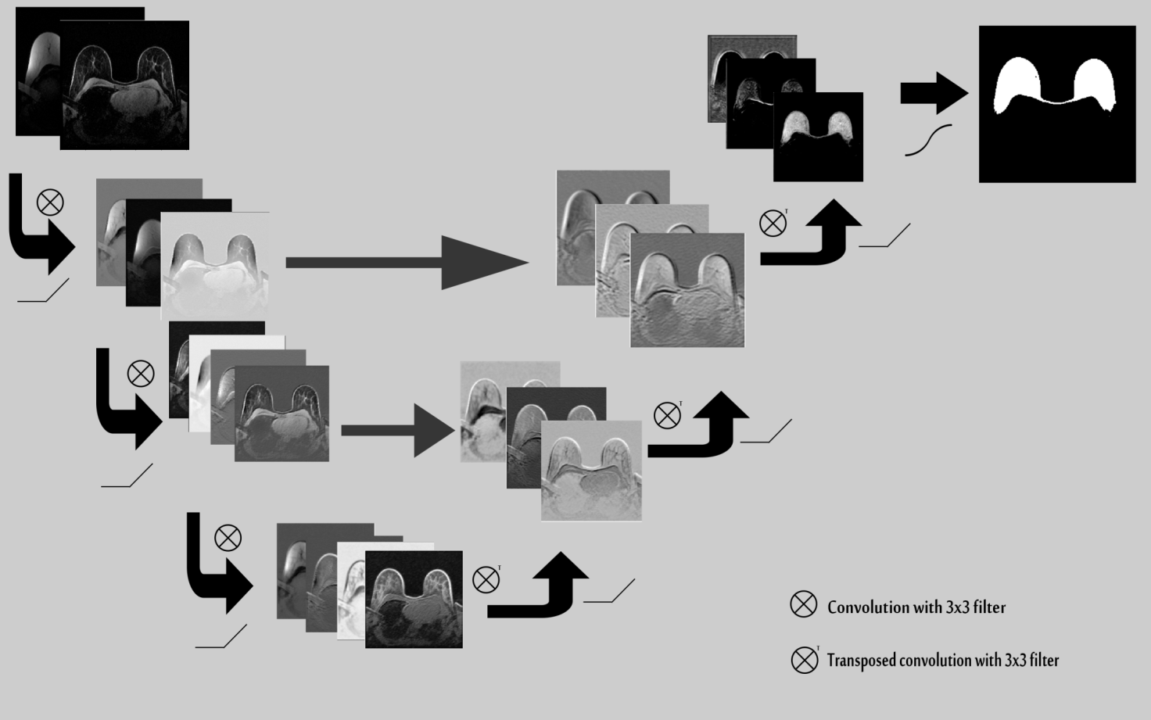
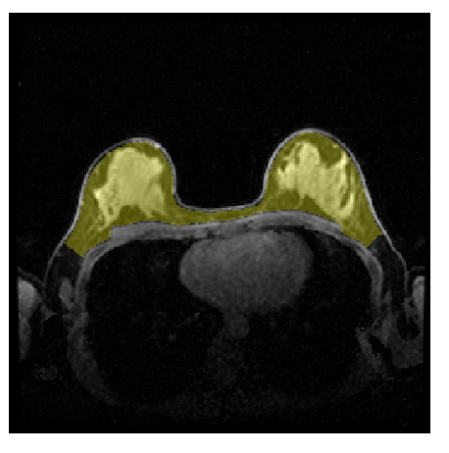
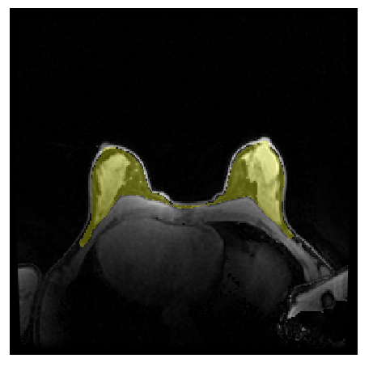
Segmentation of Fat/Water Breast MR images with Deep Learning Segmentation Model
Trained with 120 datasets
Achieves Dice overlap score of 0.986
Effective across all breast densities
Can be applied to segment new slices at <4ms/slice

Slide 3
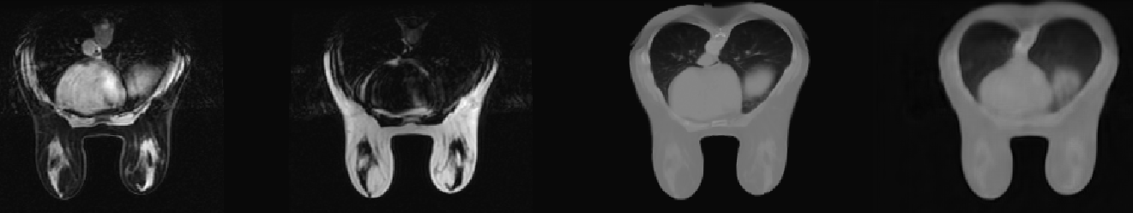
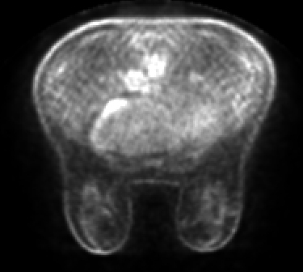
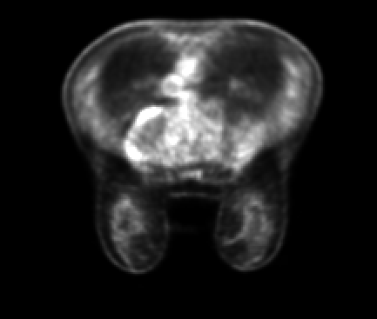
Standard PET Attenuation Correction fails on these images
Truncated MR
LAVA-Flex
images
1x1
BatchNorm+ELU
3x3
3x3
2x UpSampling
BatchNorm+ELU
1x1
3x3
3x3
1x1
3x3
Concatenate
Concatenate
1x1
3x3
3x3
1x1
3x3
BatchNorm+ELU
Concatenate
4x4 s2
BatchNorm+ELU
BatchNorm+ELU
3x3
3x3
1x1
3x3
3x3
2x UpSampling
Truncation-Completed Linear Attenuation Map
3x3
BatchNorm+ELU
Concatenate
1x1
1x1
Concatenate
BatchNorm+ELU
1x1
3x3
3x3
4x4 s2
3x3
BatchNorm+ELU
Concatenate
1x1
3x3
3x3
BatchNorm+ELU
3x3
3x3
CT-derived Target Attenuation Map
Concatenate
3x3
1x1
2x UpSampling
BatchNorm+ELU
BatchNorm+ELU
4x4 s2
1x1
BatchNorm+ELU
Concatenate
1x1
3x3
3x3
3x3
Truncation Completion and Generation of Linear Attenuation Map for Breast PET/MR Attenuation Correction
PET Attenuation Correction

Slide 4
Steps needed to implement DL
Deep Learning for Segmentation
Obtain Masks
Obtain Training Images
Loading and formatting masks
Clean, Organize, and Curate Training Images
Design model
Select Appropriate Model
Create loss function
Train and Validate Model
Train model
Obtain New Images and Apply Model
Retrain model

Slide 5
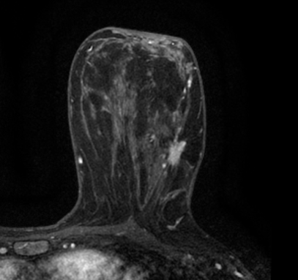
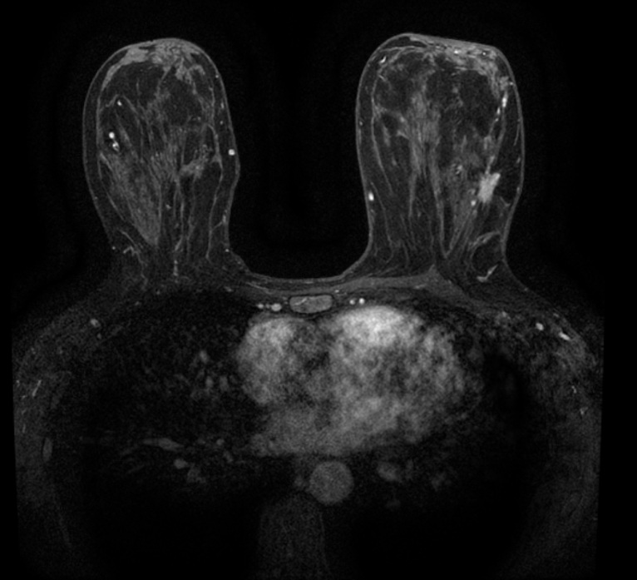
Classification Models
Hidden Layers
Not Cancer
Cancer
Output Layer
Input Layer

Slide 6
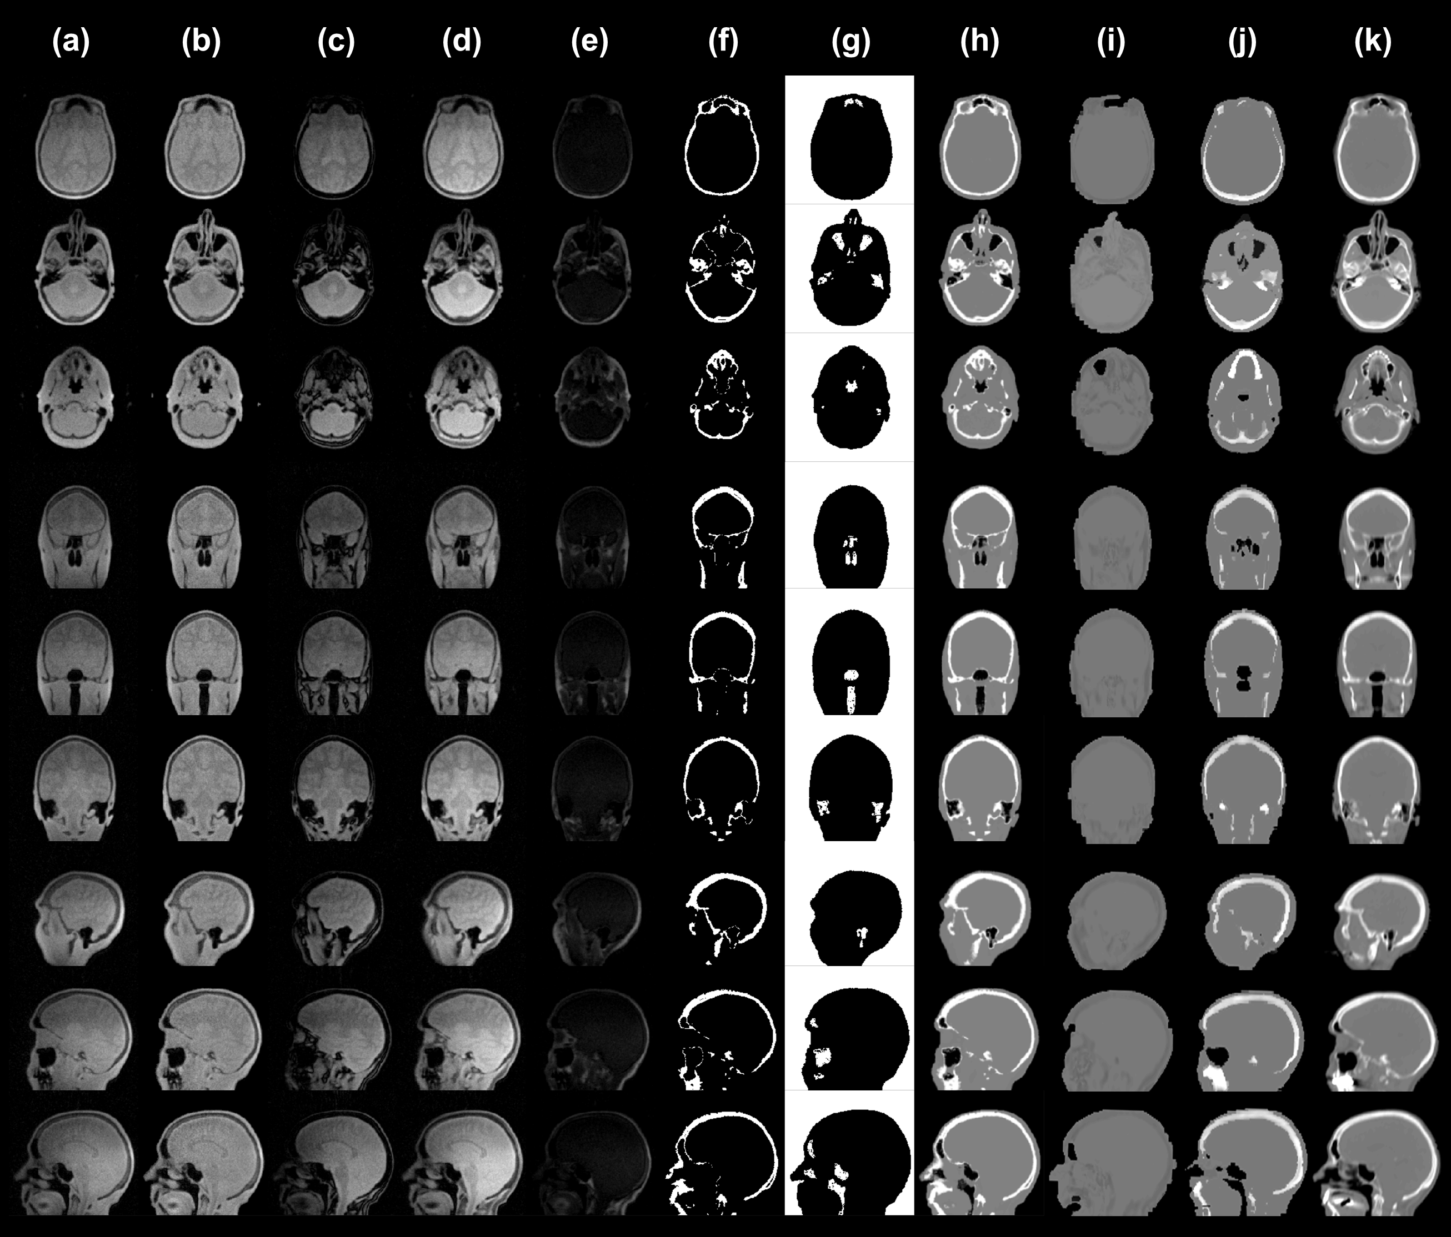
Image-to-image translation Models

Slide 7
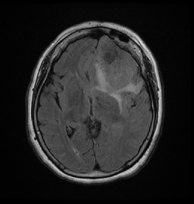
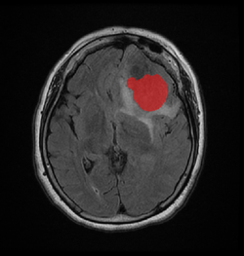
Segmentation and Synthesis require additional architecture
Input
Model
Output
Provide voxel-wise classification to input
Example of Applications
Fast segmentation
Identify suspected pathology directly on images
Perform attenuation correction for PET/MR of the brain

Slide 8
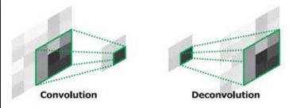
New Layer- Transpose Convolution
Convolution layers downsample and encode
Transpose convolution layers upsample and decode

Slide 9

Network architectures – U-net (Ronneberger, 2015)
Convolutional Encoder-Decoder
Includes skip connections for maintaining spatial resolution

Slide 10
Today’s Examples
Image segmentation task
Segmentation lungs from chest CT volumes
Using publicly available LCTSC dataset
Image Synthesis task
Predict T2 MR image from T1
Using BRATS dataset

Slide 11
Our Segmentation Model
Input Image
Convolution Layer
Convolution Layer
Convolution Layer
Convolution Layer
Strided
Convolution Layer
Transpose Strided
Convolution Layer
Convolution Layer
Output Mask
Convolution Layer
Convolution Layer
Convolution Layer
Transpose Strided
Convolution Layer
Strided
Convolution Layer
Convolution Layer
Convolution Layer

Slide 12
Our Segmentation Model- with skip connections
Input Image
Convolution Layer
Convolution Layer
Convolution Layer
Convolution Layer
Strided
Convolution Layer
Transpose Strided
Convolution Layer
Convolution Layer
Output Mask
Convolution Layer
Convolution Layer
Convolution Layer
Transpose Strided
Convolution Layer
Strided
Convolution Layer
Convolution Layer
Convolution Layer

